Slide 1
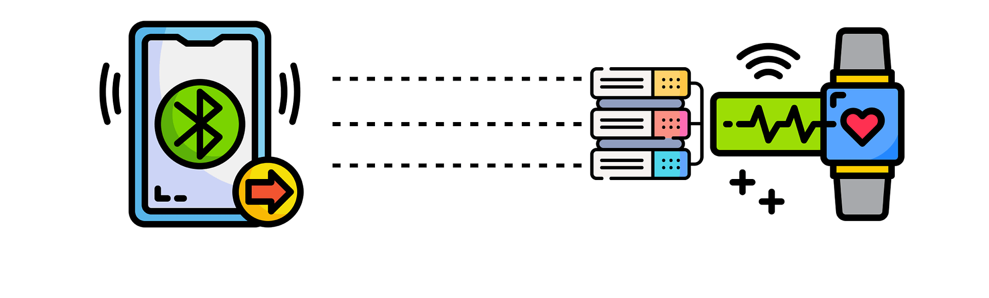
Developing Fast DDS based Android Companion Application to Collect Data from PineTime64 smart watch
Submitted By
MD. SIDDIQUR RAHMAN TANVEER – 202417180
F M JAHIDUZZAMAN – 202417000
Advisor Name- BASEM AL-MADANI
Co-Advisor Name- Farouq Aliyu Muhammad

Slide 2
Objectives
Research Goals: Implementing Fast DDS XRCE on the PineTime64 smartwatch for lightweight DDS communication.
Hypotheses (if applicable): "Fast DDS XRCE can be successfully implemented on PineTime64 to enable DDS communication without compromising performance."

Slide 3
Methodology
Research Design: Design includes setting up the ESP32 SWD programmer, preparing the PineTime64, and flashing firmware with DDS protocols. Also Testing communication between the PineTime64 and DDS Agent using Fast DDS XRCE.
Data Collection: Logs from the Arduino IDE serial monitor and Observations from the flashing process and any output from the PineTime smartwatch.
Software: Arduino IDE, ESP32 core library, AsyncTCP, ESPAsyncWebServer, and WiFiManager.
Hardware: ESP32, PineTime64 smartwatch.
Analysis Plan: Monitor communication between PineTime64 and DDS Agent using debug logs.

Slide 4
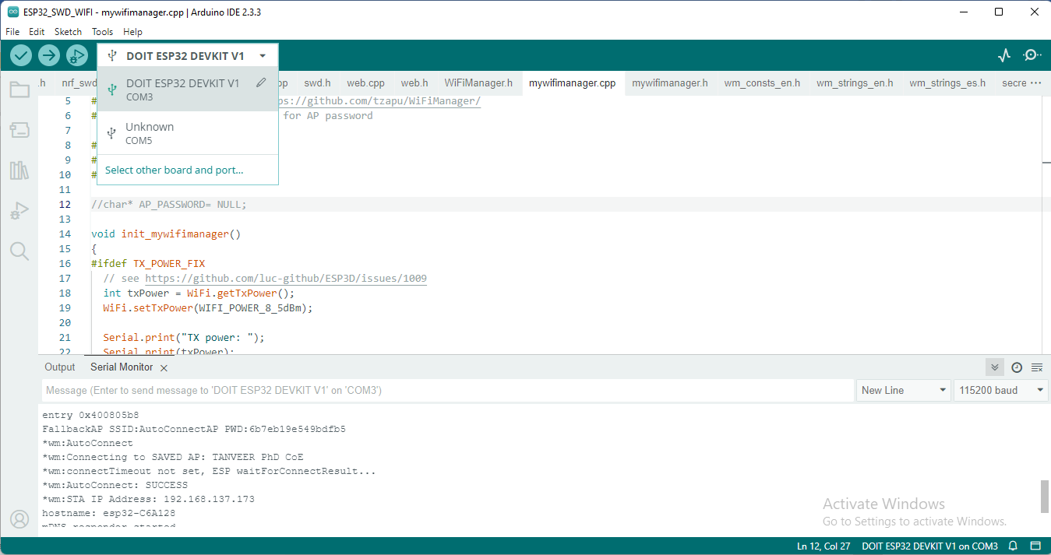
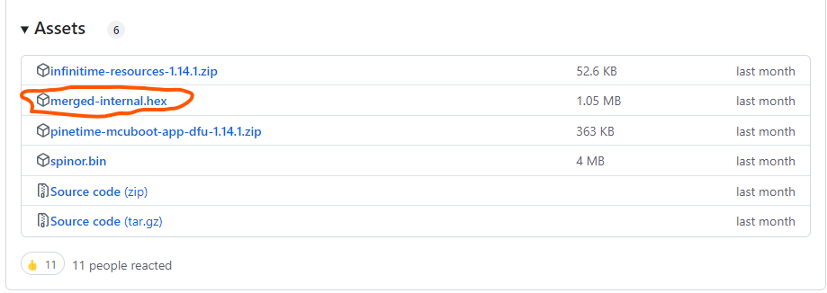
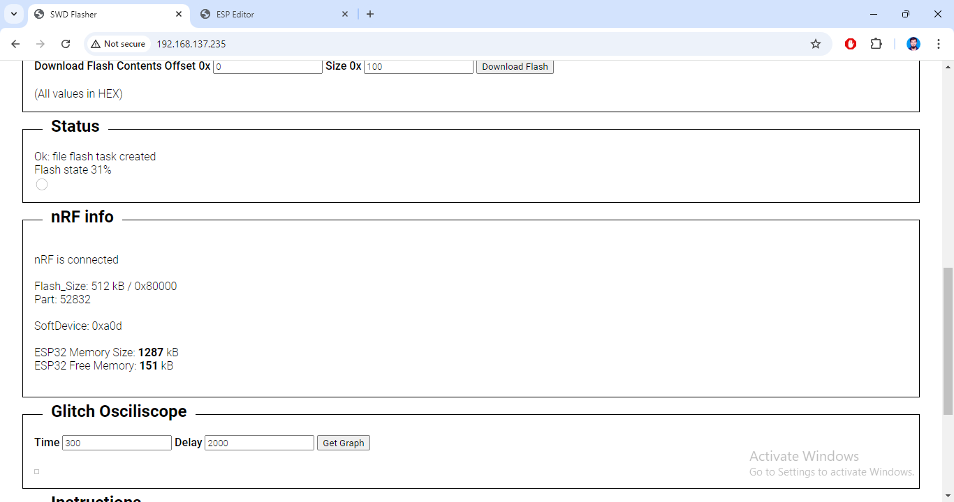
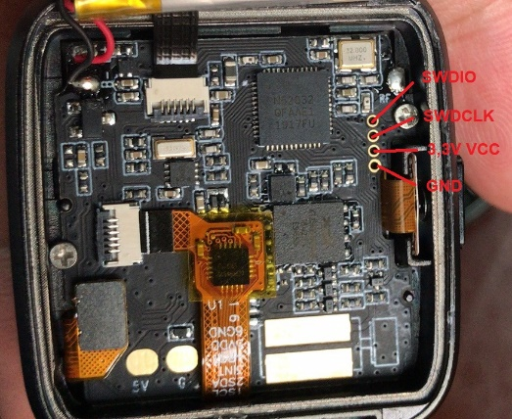
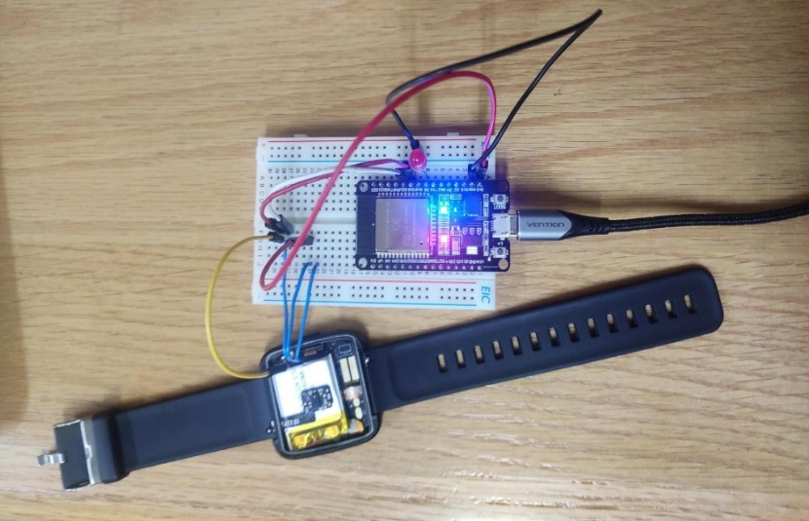
PineTime64 Smart Watch Firmware Update
Tasks Completed:
Connected PineTime64 to ESP32 via SWD.
Flashed PineTime64 firmware using ESP32-provided web interface.
Verified flash operation using logs.
Connecting EXP32 with PineTime64 via Arduino IDE
PineTime64 basic Firmware .hex file from Github source
SWD PINOUT
ESP32 connection with PineTime64
Firmware Flashing Web Interface created by ESP32

Slide 5
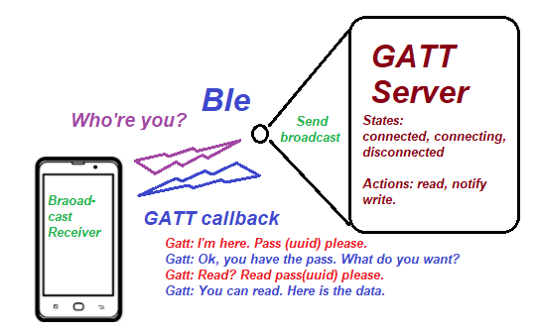
Android Companion Application
Bluetooth Low Energy
Android provides built-in platform support API that apps can use to
Discover devices
Query for services
Transmit information.
Generic Attribute Profile (GATT)
The GATT profile is a general specification for sending and receiving short pieces of data known as "attributes" over a BLE link. All current BLE application profiles are based on GATT
Attribute Protocol (ATT)
How does Android Application Connect to GATT Server?
GATT is built on top of the Attribute Protocol (ATT).
Uniquely identified by a Universally Unique Identifier (UUID)
128-bit format for a string ID used to uniquely identify information
The attributes transported by ATT are formatted as characteristics and services.

Slide 6
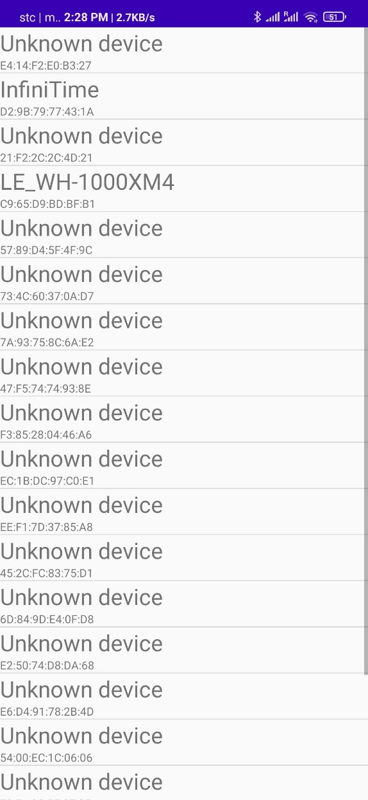
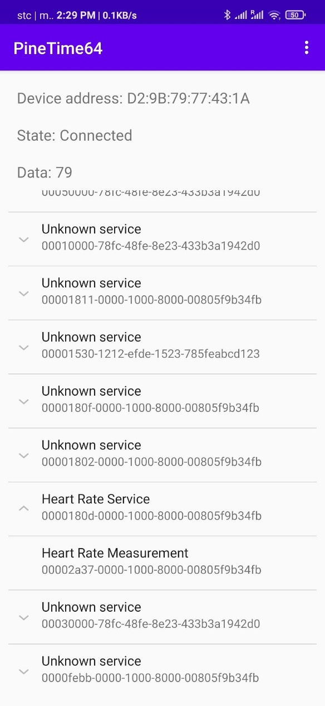
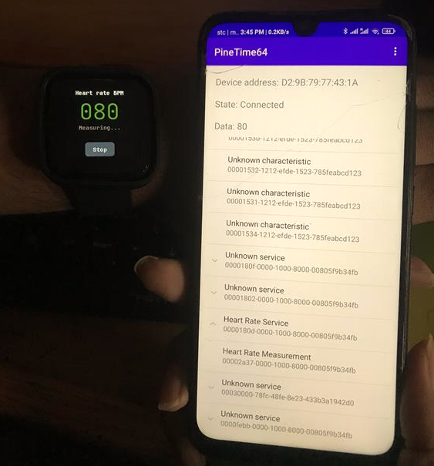
Android Companion Application

Slide 7
Conclusion
Vision: Implement Fast DDS based Android Application to connect PineTime64 to analyze the different QoS policies

Slide 8
Thank You

